Slide 1
GooD morning

Slide 2
Presented by:
Khodiza Khatoon
Charkoilash
Government
Primary School.
Hatiya, Noakhali.
Lesson Identity:
Class-Two
Subject: English

Slide 3
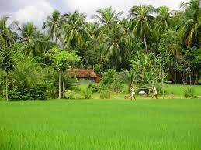
Objectives:
Students will be able…
to recognize the cardinal numbers 1-4
to read and write cardinal numbers 1-4 both in figures and in words.

Slide 5
Let’s see the video
What can you see in the video?
Numbers Train

Slide 6
Today our lesson is
Numbers
Lesson- 1 -3
Page- 4

Slide 7
Look, listen and say:
1
Cardinal
one
Cardinal
one

Slide 8
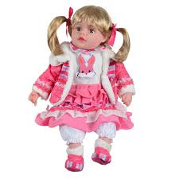
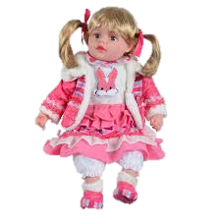
Look, listen and say:
2
Cardinal
2
two
Cardinal
two

Slide 9
Look, listen and say:
3
three

Slide 10
Look, listen and say:
4
four

Slide 11
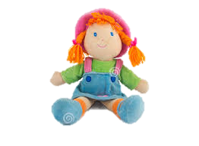
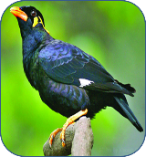
Look, listen and say:
Picture
Figure
Word
1
one
2
two
3
three
4
four

Slide 12
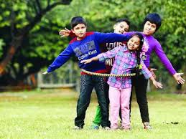
How many children?
3
4
5
four

Slide 13
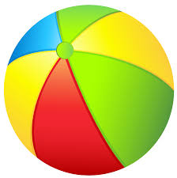
How many balls?
3
three

Slide 14
Match the numbers with words:
P.W
Time: 5 minutes
Number
Word
4
three
2
one
3
two
1
four

Slide 15
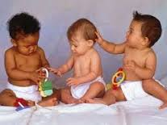
Write the missing numbers by using pictures:
I.W
Time: 5 minutes
1
2
3
4
one
two
three
four

Slide 16
Write in words & re-arrange the numbers:
S.G.W
Time: 5 minutes
Numbers
Words
3
three
1
one
4
four
2
two

Slide 17
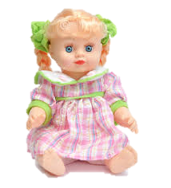
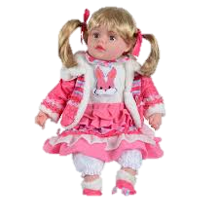
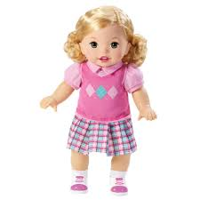
Checking learning
W.C.W
Count and write the numbers:

Slide 18
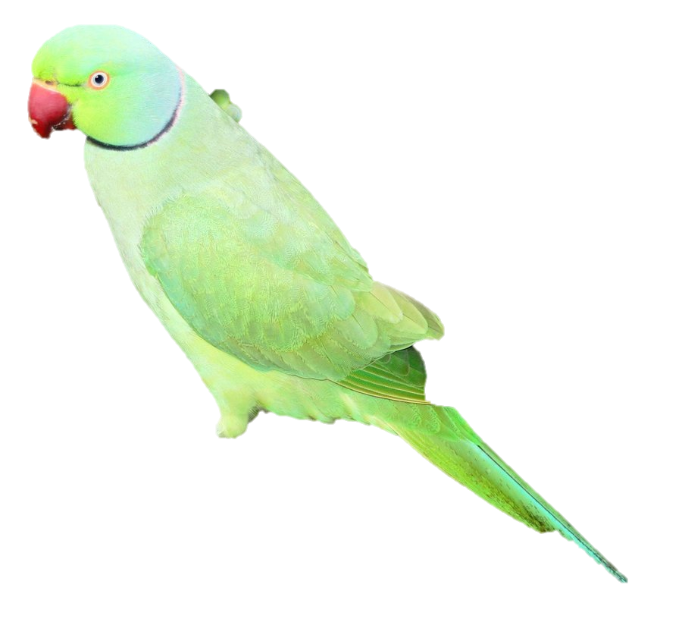
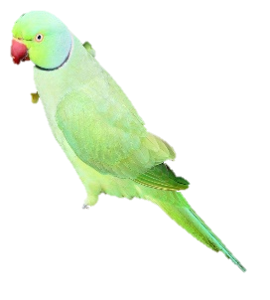
Thank you all

